Slide 1
IMDB MOVIE ANALYSIS

Slide 2
PROJECT DESCRIPTION
Given dataset of IMDB movies having information about movie actors, directors, critics, audience, genre, rating, facebook likes etc.
Our task is to analyse the data and find major trends, popular movies, genres, directors and give insights on the basis of given dataset.

Slide 3
APPROACH
• Understanding the data • Getting familiar with the data values and attributes • Analysing the data by applying filters and formulas • Visualise the data with graph/ charts to get better understanding
TECH STACK USED
Microsoft Excel

Slide 4
A. CLEANING THE DATA
Dropped columns which are not needed for the analysis
Replaced blanks with values like 0 or ’zzz’ so that they don’t interfere in analysis
After cleaning data set has these columns - director_name, num_critic_for_reviews, gross, genres, actor_1_name, movie_title, num_voted_users, num_user_for_reviews, language, budget, title_year, imdb_score

Slide 5


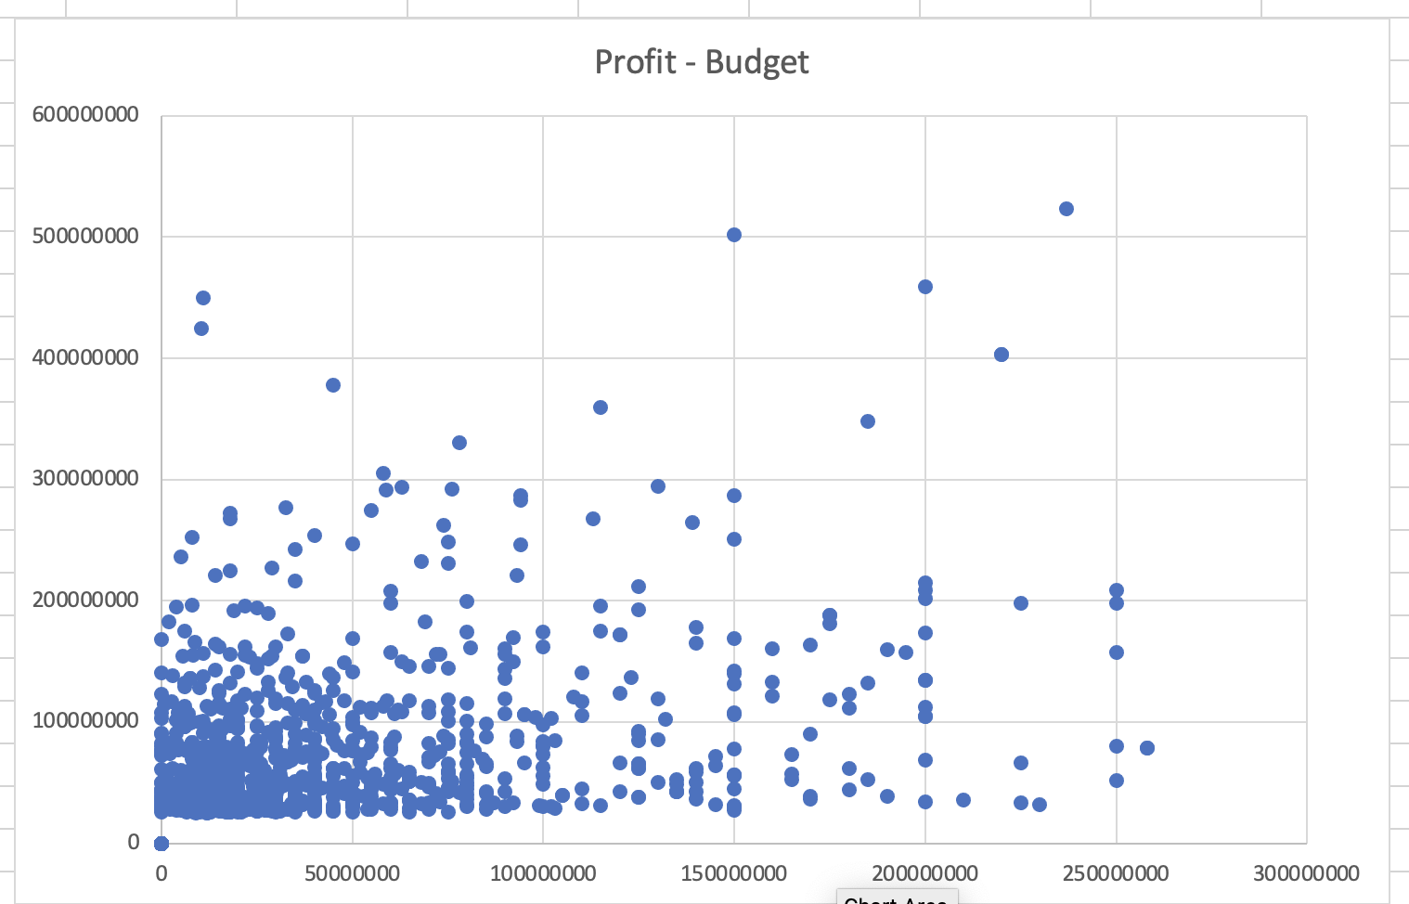
b. Movies with highest profit
Profit – budget chart of top 1000 movies according to profit
Y axis – profit
X axis – budget
From this graph we can infer that most of the movies which are low budget are able to earn low to medium range profits. On the other hand, there are few movies which are high budget and are able to earn very high profits.

Slide 6
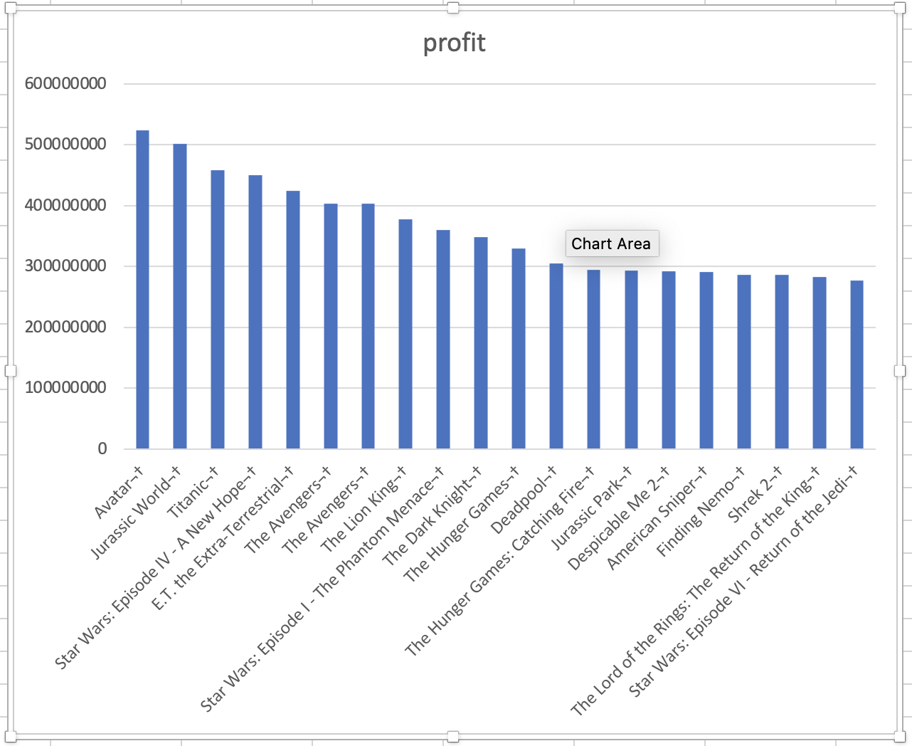
TOP 20 Movies with highest profit
‘Avatar’ is the most profitable movie according to given dataset.

Slide 7
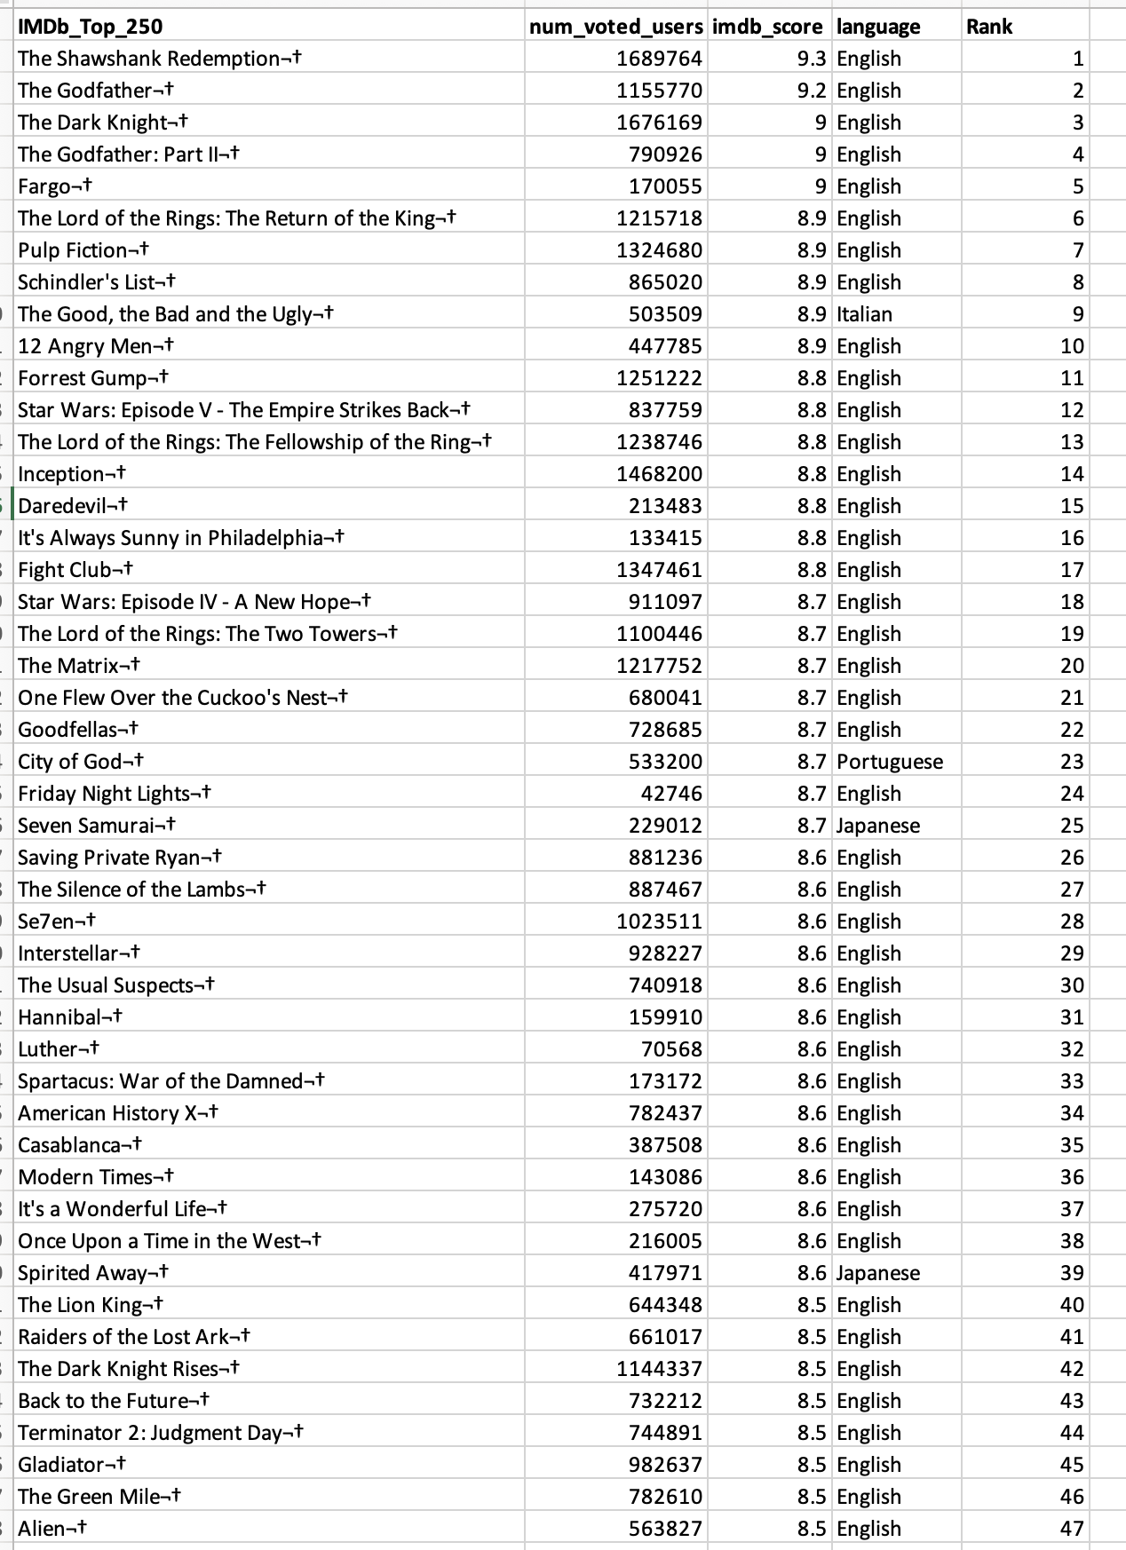
C. TOP 250 MOVIES WITH HIGHEST IMDB RATING
NUMBER OF VOTED USERS > 25000
Highest IMDB rating movie is ‘The Shawshank Redemption’ having 9.3 IMDB rating, in English language.

Slide 8
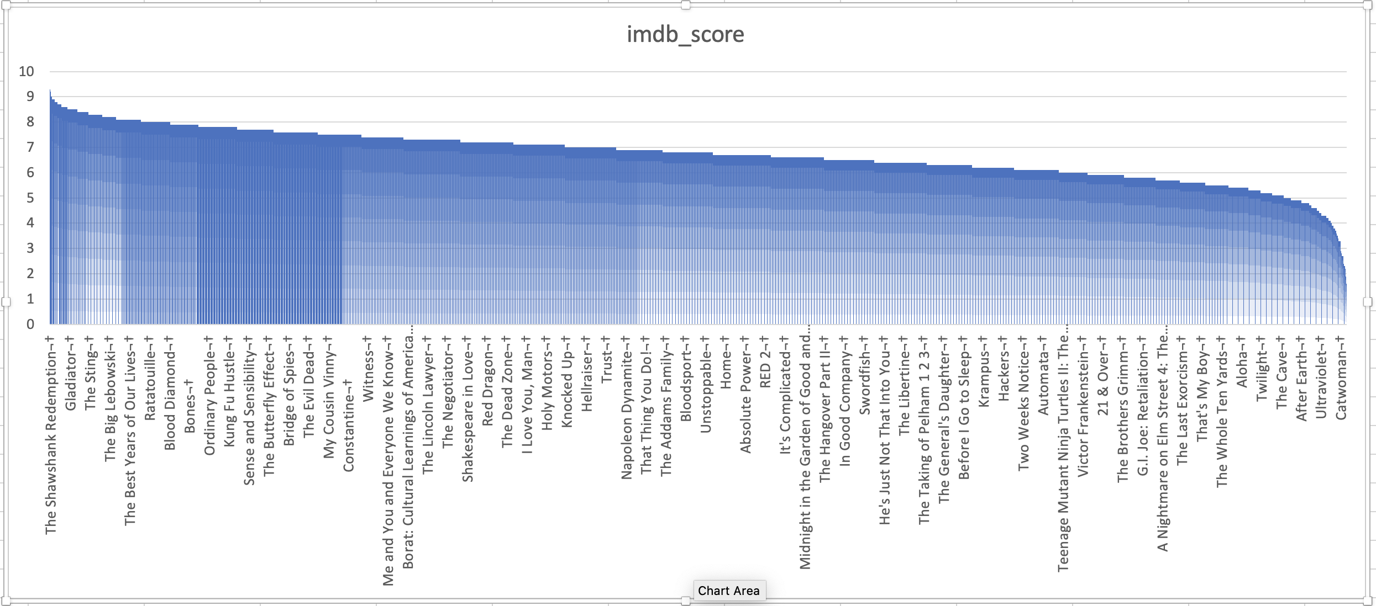
TOP 250 MOVIES WITH HIGHEST IMDB RATING

Slide 9
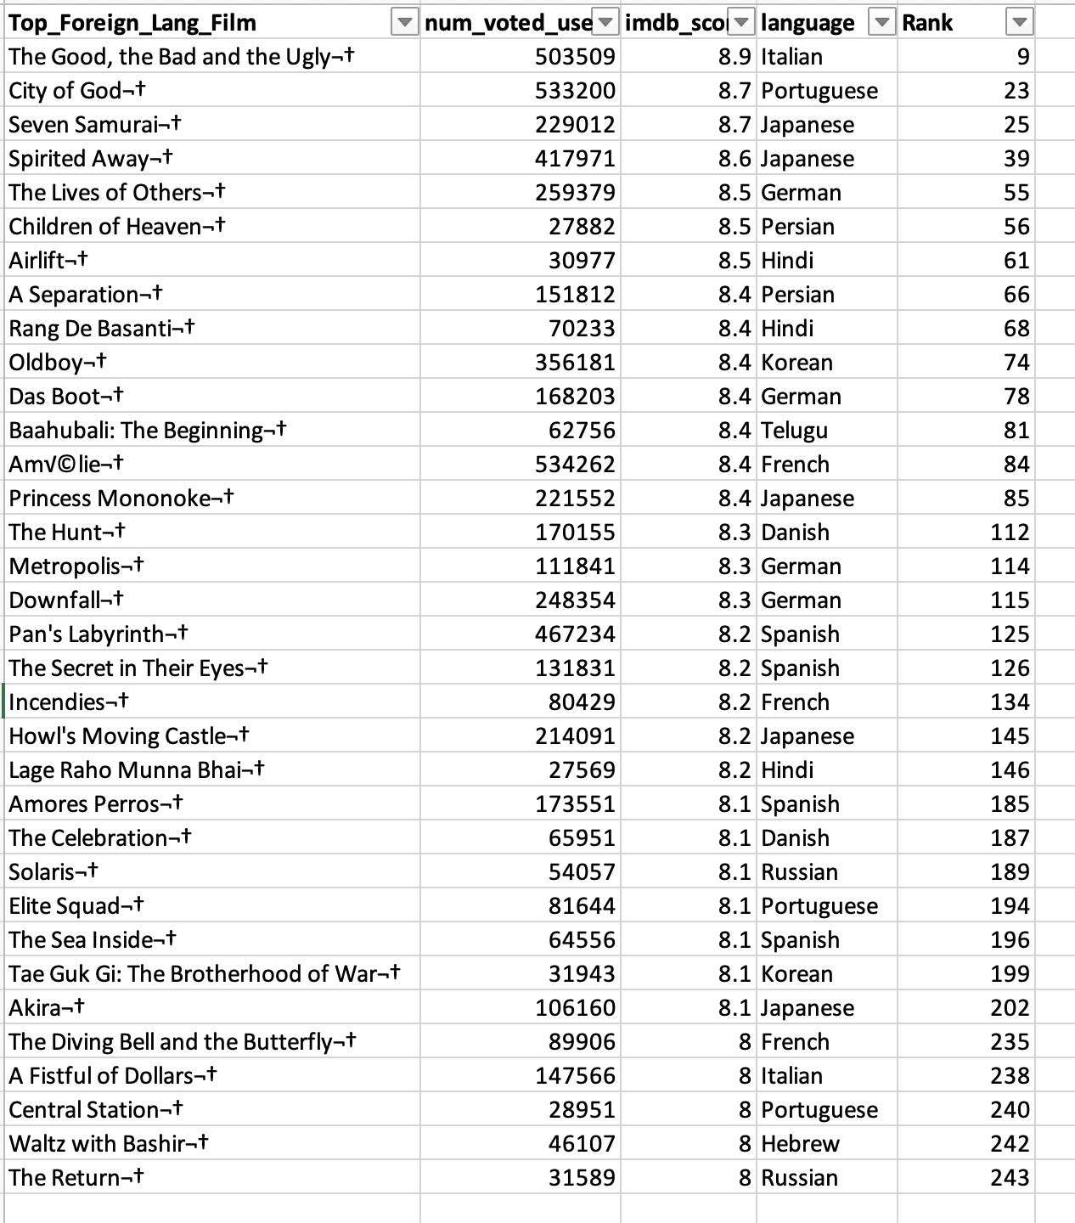
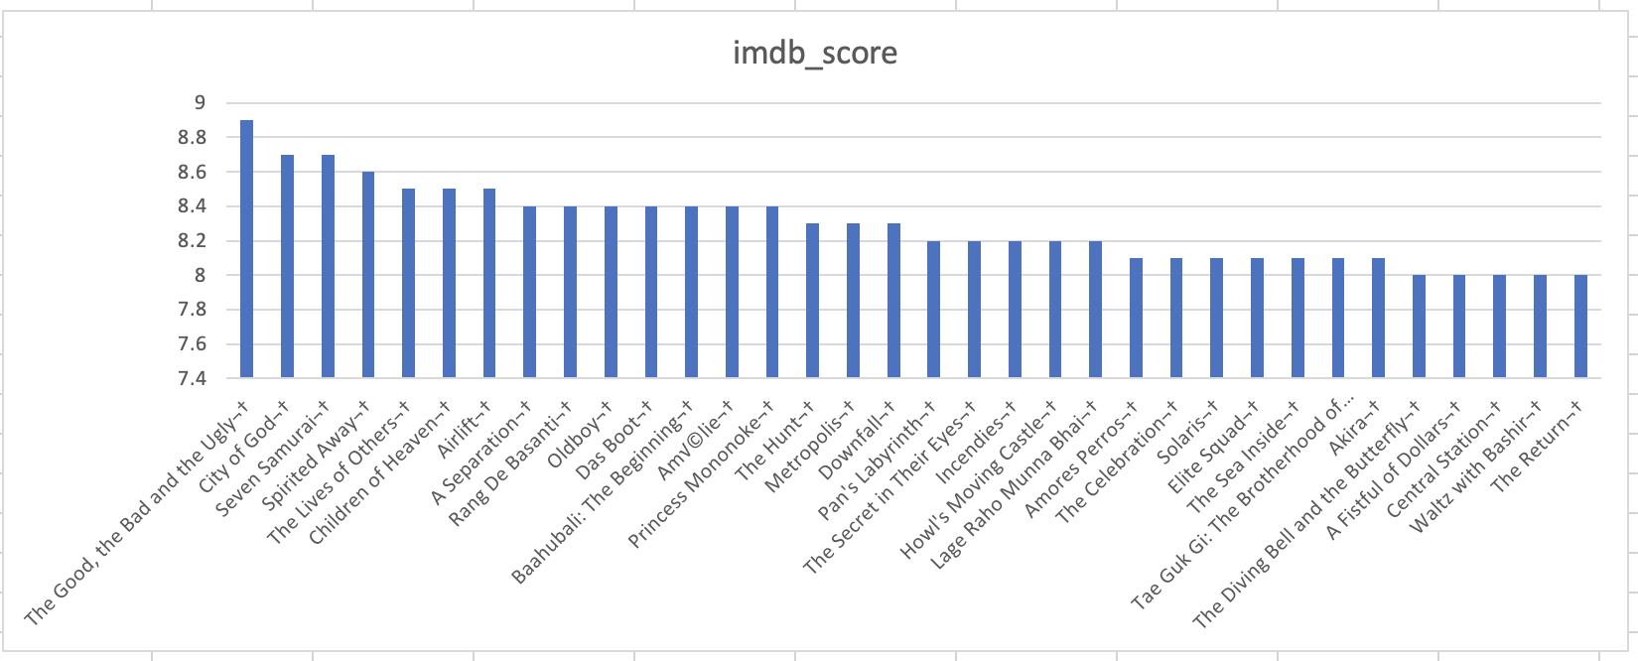
Top Foreign language films
Highest IMDB rated foreign language movie is ‘The Good, the Bad and the Ugly’ having 8.9 rating in Italian language. Overall rank of this movie is 9th.

Slide 10
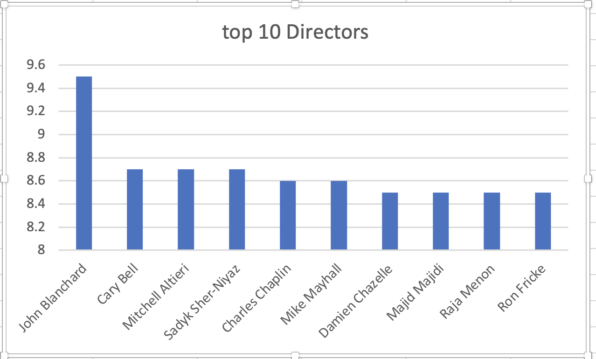
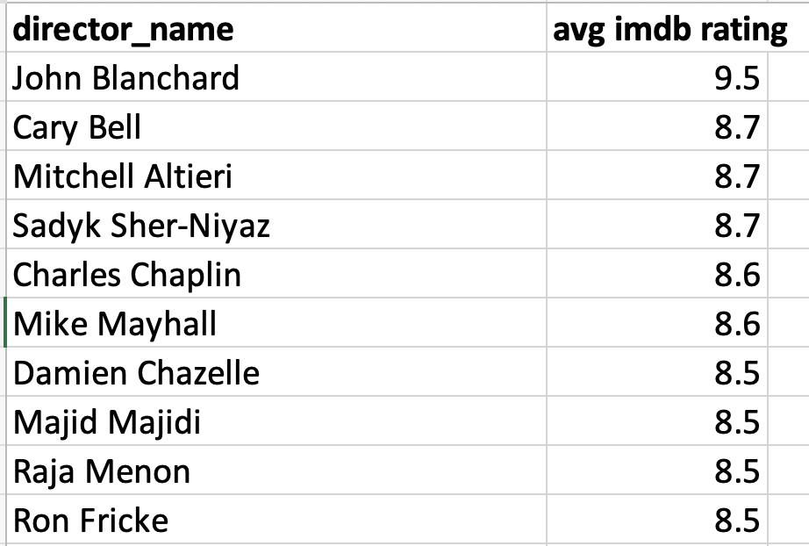
d. Top 10 directors by imdb rating
Best director is John Blanchard having 9.5 avg. IMDB rating.

Slide 11
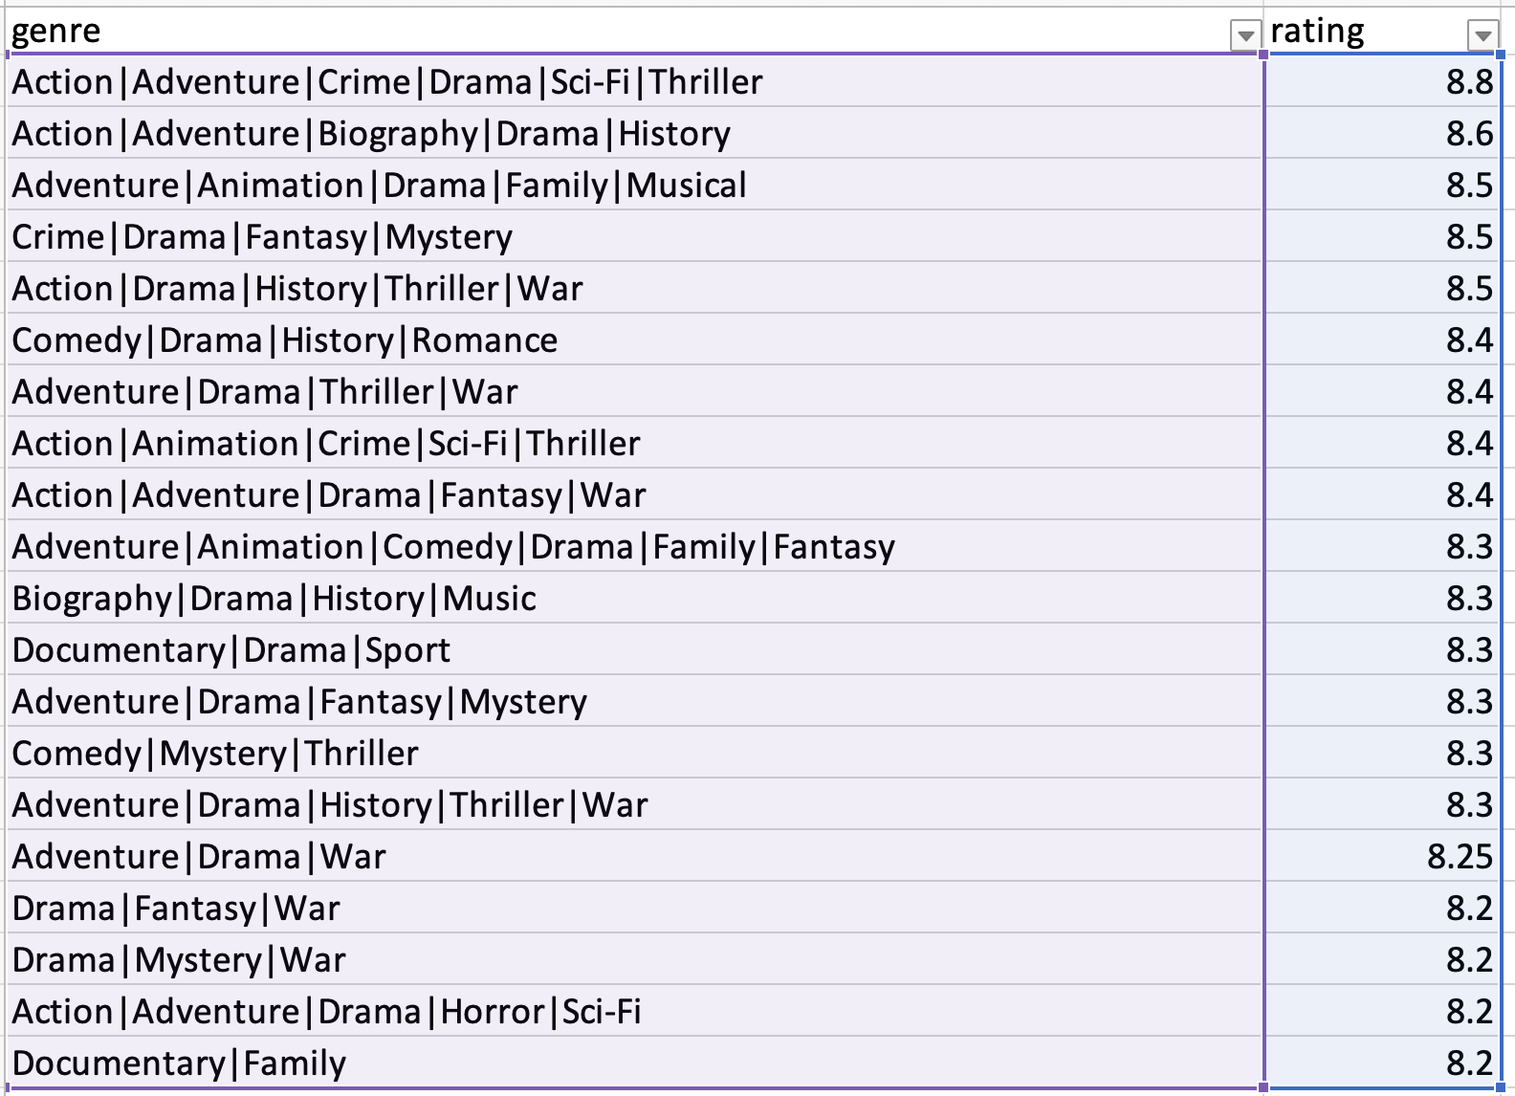
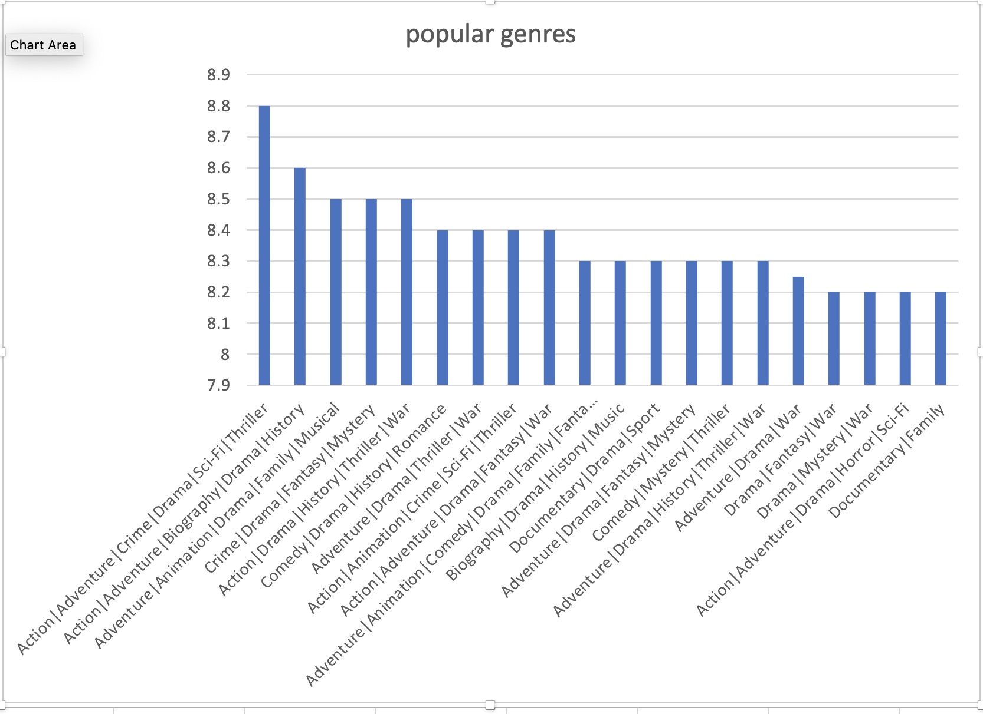
e. Popular genres by imdb rating

Slide 12
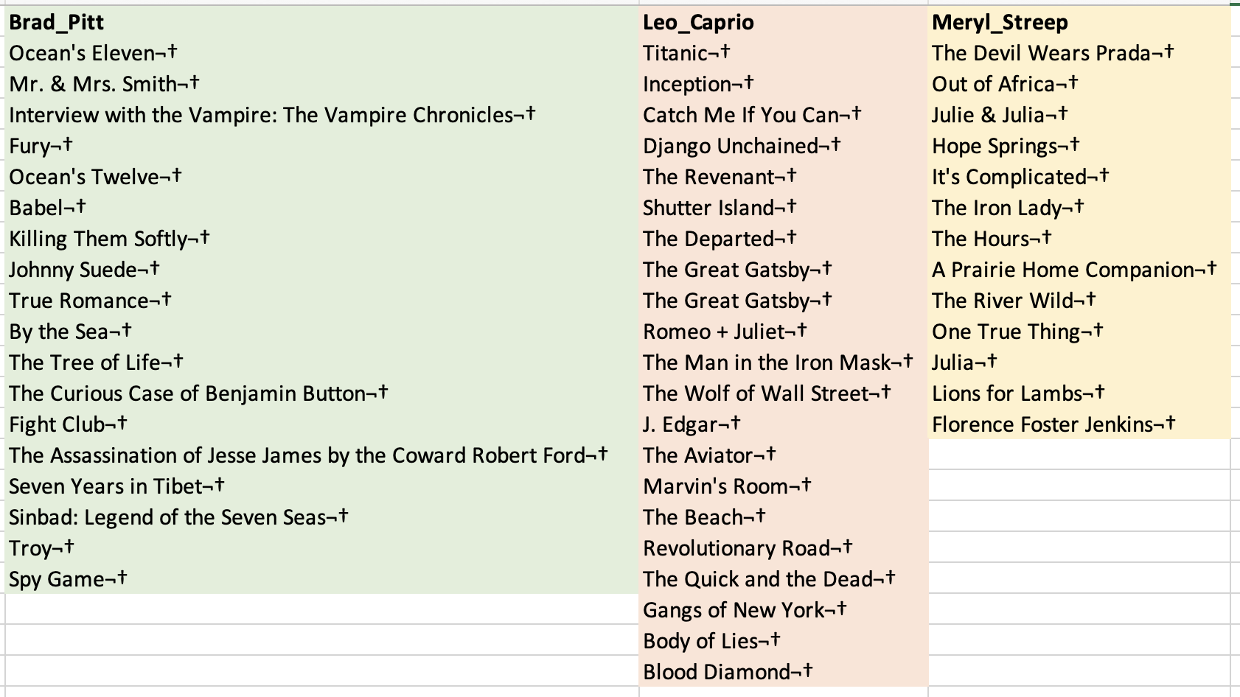
f. popular actors

Slide 13
Audience favorite actors

Slide 14
Critic favorite actors

Slide 15
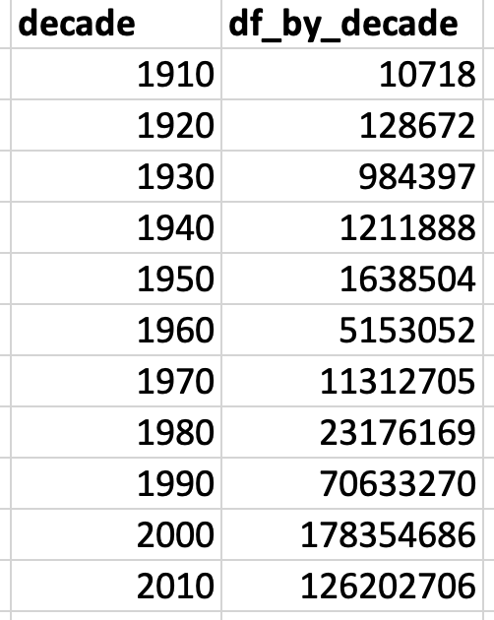
Sum of users voted in each decade
From 1910s to 2000s, no. of users voted have increased but their number decreased in 2010s.

Slide 16
result
Using Microsoft excel, I analyzed IMDB movie dataset and I find out that on average, low budget movies have more possibility to earn good profits whereas very few high budget movies can earn high profits.
I listed out top directors, movies, popular actors and genres according to IMDB rating.
As the years pass by, a greater number of users voted for movies, and we get more correct ratings.

